Slide 1




Appendix E - Sample LTV patient home bedroom floorplan:
This document is designed to be used as an exemplar room layout for a Child/Young Person returning home on LTV.
This is a working document. Please make sure you are using the latest version by checking the version number and date updated below. The latest version of the document is available here https://www.wellchild.org.uk/10-principles-for-complex-discharge/
Review date: May 2027
Version | 3
Updated | May 2024

Slide 2
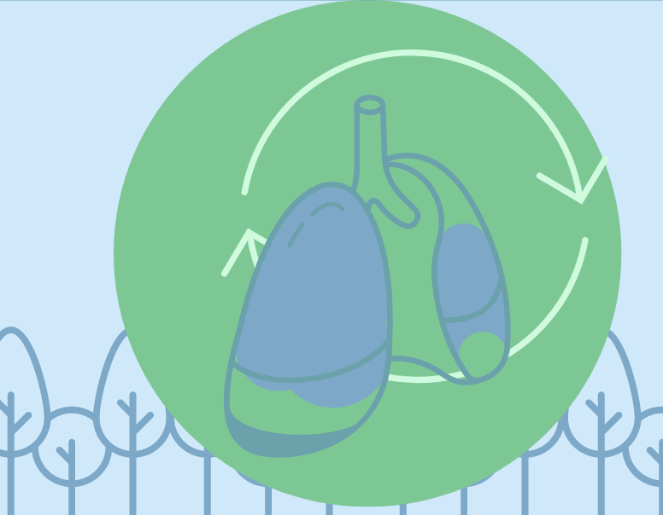
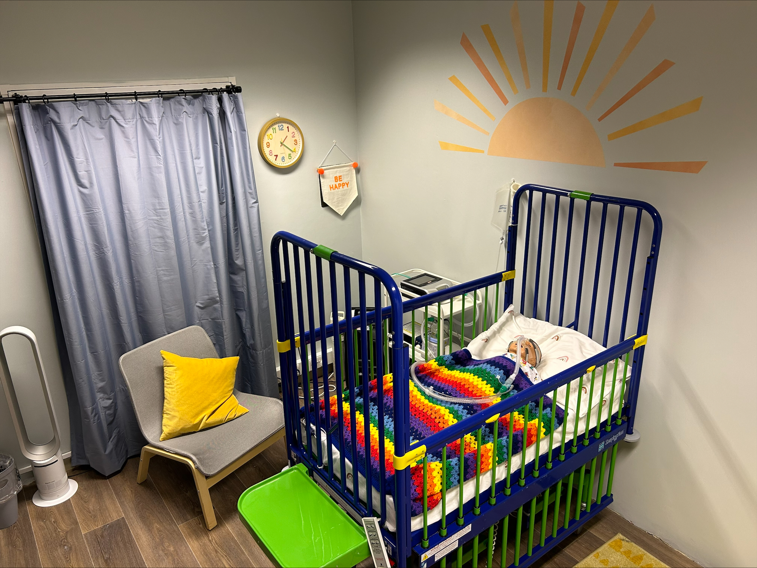
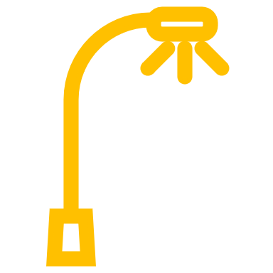
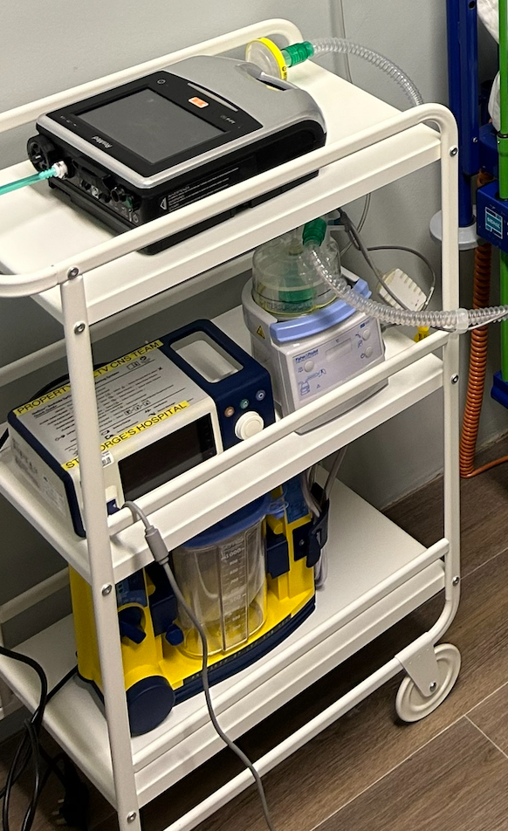
Example of an LTV Patient home bedroom floorplan
Ventilator
Wardrobe/Storage
Oxygen supply(if applicable)
Bedside Storage/ Spare Ventilator (if applicable and unable to fit onto trolley)
Lamp
Saturation monitor
Suction Machine
& suction catheters
External humidifier (if applicable)
Door
The room would ideally be located close to a sink for regular handwashing. All emergency equipment should be easily accessible and by the bedside. All oxygen equipment requires home installation assessments, please speak with your specialist centre for advice. Useful information/summaries should be kept/displayed at the bedspace for easy access.
Note: This is a sample diagram and photo of the room layout, it does not need to be identical to this. Please seek advice from your LTV Team/local teams.
High backed arm chair

Slide 3
Example of an LTV Patient home bedroom floorplan
Here are some key points to consider:
The child’s room needs to be big enough to accommodate all of the items in the sample floorplan, a double room is usually sufficient.
It is important that the bed/cot can be accessed easily from both sides, to enable child and parent/carer safety when completing daily cares and tracheostomy/tape changes.
The carer/nurse must be able to see the child and their monitoring machines from the location of the chair. This chair should be supportive and comfortable but should not recline as the carer/nurse is required to be awake during the night.
It is recommended for electrical power sources to have valid electrical safety certification, please seek advice from your home assessment team on the power source criteria as this may vary depending on your equipment voltage and property type.
A bedside lamp should be available in order for the carer/nurse to see the child and equipment clearly during the night.
The ventilator trolley should be stable with 4 legs with wheels. It should have a second tray lower than the ventilator for the humidifier, spare ventilator and any other equipment. A humidifier clamp can also be used on one of the legs of the trolley to secure the humidifier.
Suction machine, nebuliser, oxygen and emergency bag/blue box should be placed adjacent to the bed to enable easy access or on the ventilator trolley if enough space.
Ideally, toilet facilities for the carer would be located on the same floor as the child's room however if this is not possible then arrangements would need to be made with the family to ensure that the child is safe while the carer/ nurse takes a short toilet break.
Please seek further advice from your local community nursing and OT team.

