Slide 1




Travel & LTV
Challenges and pitfalls
Dr Ross Langley BSc PhD MBChB MRCPCH
Paediatric Respiratory & Sleep Consultant, RHC, Glasgow
Ross.Langley@nhs.scot

Slide 2

Outline
Challenges
Pre trip planning
Trip
  Flight
  Destination
  Other transport

Slide 3
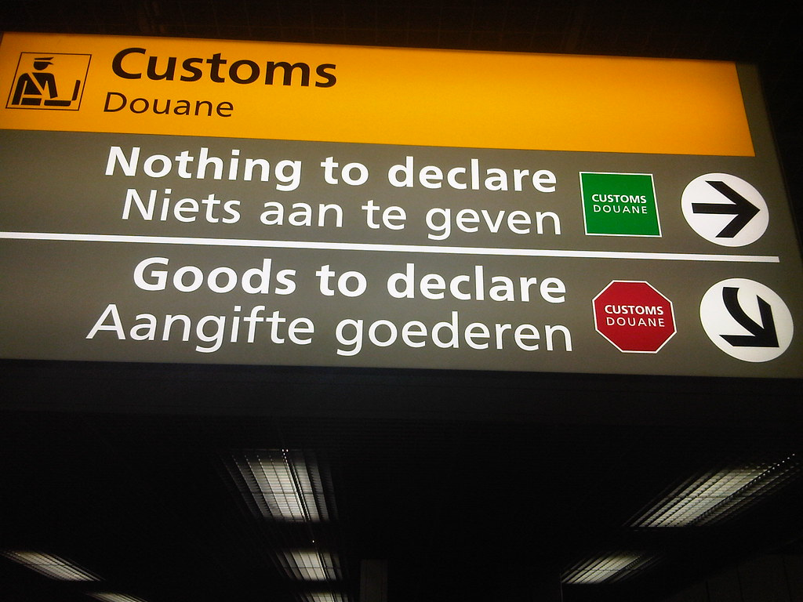
Disclosures

Slide 4
Background
Kids with additional ventilation needs are living longer and encouraged to live normal lives
Foreign travel is possible – but some conditions (eg. high spinal cord injury) with handling issues may not be suitable
But - air travel causes issues

Slide 5
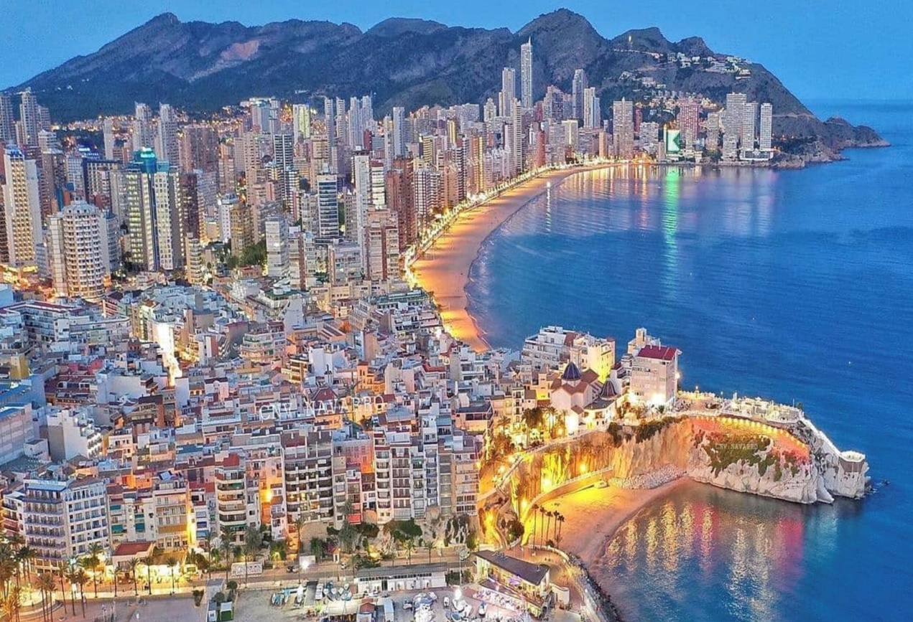
So you want to take your LTV child on holiday?

Slide 6
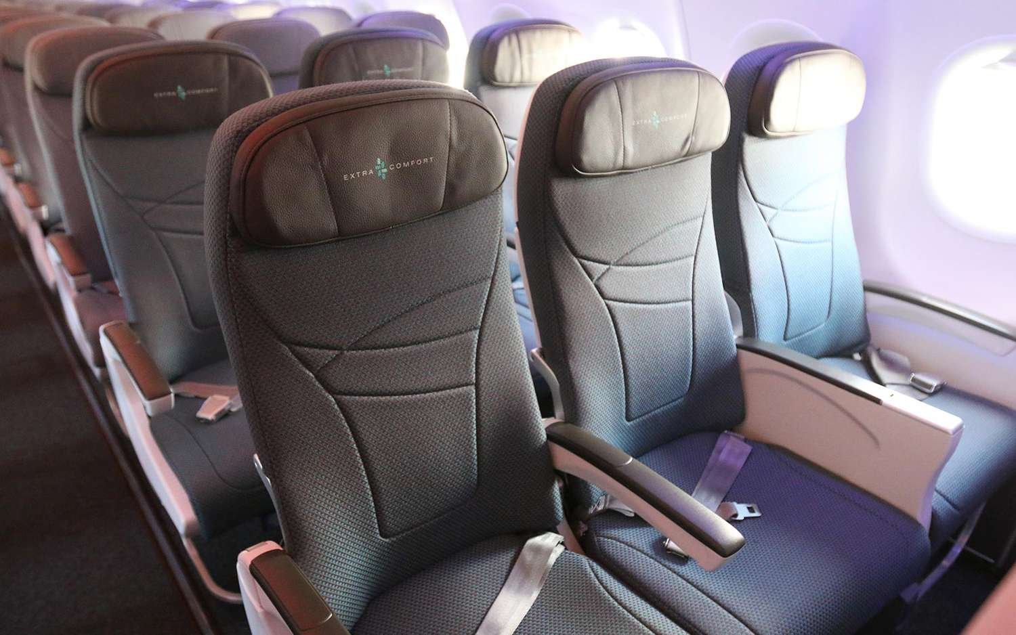
The challenge
PAEDIATRICS AND CHILD HEALTH 21:5

Slide 7
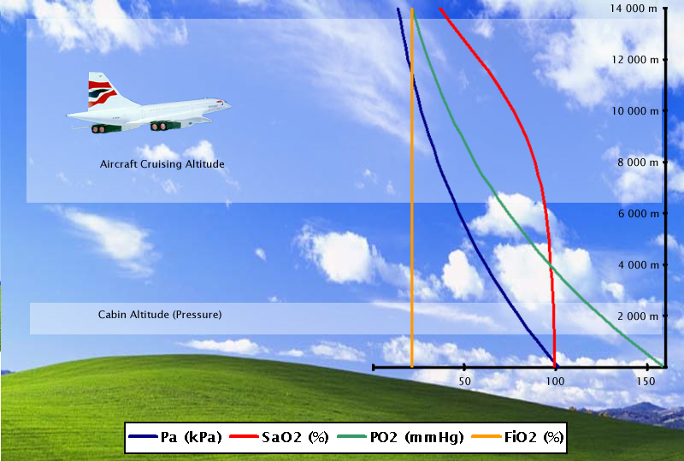
Air Travel
Typical commercial flight
  31-42,000 feet (9,400-12,800 metres)
  Cabin pressurised to the equivalent of 8,000 feet (2,438 metres)
  Equivalent of breathing 15.1% FiO2 (at sea level)

Slide 8
Air travel
  Normal response is increased respiratory rate and degree of hyperventilation
  If impaired drive or weak respiratory muscles – may not mount appropriate response

Slide 9
1st Steps
  Communicate with the LTV team – ASAP
  Communicate with airline
    All airlines have different policies
  Communicate with insurance company
Medical team
  Arrange fitness to fly
  May need to write letter – some airlines have specific paperwork

Slide 10
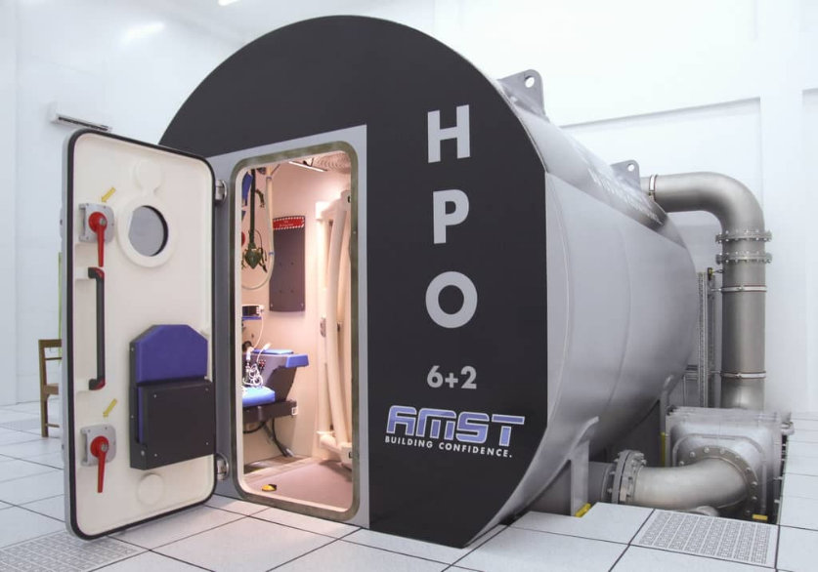
Fitness to Fly/Hypoxic Challenge Testing (HCT)
✓
Simulate the cabin environment.
Hypobaric Chamber?? (~£70,000)
Altitude of 8,000 feet is equivalent to a F_{i}O₂ = 15.1%
Please note, this investigation is a hypoxic challenge test and not a fit to fly test. The test is an assessment of the effects of acute hypoxia and assists in deciding whether a child needs extra O₂ during flight but does not confirm whether they are fit to fly. It does not cover other contraindication such as the effect of hypobaric conditions on trapped air and bullae.
Notes:
Typically blood gases taken

Slide 11
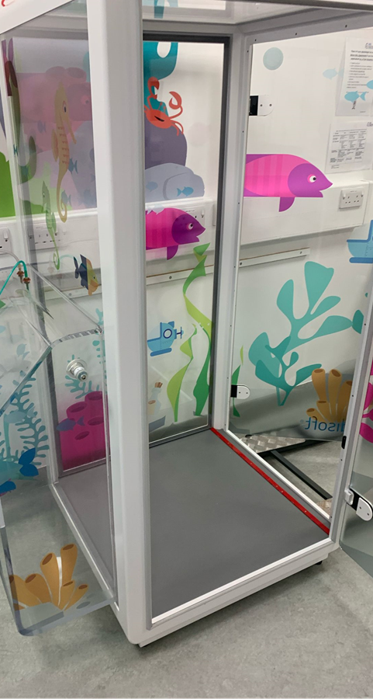
Specifics of HCT in LTV Patients
Tracheostomy patients can’t be tested via a venturi mask.
Tracheostomy ventilated wheelchair patients can’t fit in a conventional body box. Wheelchair box is required.
Suction device also useful to have if done in the box (but parent would also be required to squeeze in!)
Carbon dioxide monitoring may also be required.
Length of flight, will they sleep? – CCHS, ventilator will be required.

Slide 12
Some important planning information on timing of the HCT
Airlines usually like the test done within 3 months but some may differ.
Some airlines need a fitness to fly assessment section on the form to be signed within 30 days of travel – not the HCT done within 30 days!
Labs are often given short notice – plan ahead.
Families may not have anything booked but want to find out to help plan a potential holiday.
Patients should be stable without acute illness to help avoid the need for repeat testing.
Those who have had a HCT in the past shouldn’t need it repeated unless there has been a change in their clinical condition.

Slide 13
Pre-trip planning
Ventilator x 2
Spare tubing/mask/filters/trachy tubes
Spare power supply cable
  Is your vent power compatible with airline supply?
  Do you have appropriate adaptor for destination country?
Instruction manual
Up to date ventilator prescription
Bag ‘n’ Mask
Spare battery
  enough batteries to cover 150 percent of the flight time

Slide 14
Pre-trip
Check destination hospital location
Arrange for local oxygen delivery (discussed later)

Slide 15
Other kit
Nebulisers
Suction
Wheelchair
Feeding pumps
Humidifiers – not currently allowed – check with airlines

Slide 16
Key points for trip
Equipment to go as hand luggage
Arrive at airport early – security may ask for you to plug in each device as a check

Slide 17
Trouble shooting
Ventilator malfunction/break down
Local hospital. Take ventilator, documents , UK medical contact details, and insurance certificate.
Local ventilation/respiratory team in the UK for simple advice, unlikely to be able to replace ventilator.
If highly dependent - switch to spare ventilator ASAP
If absolutely dependent and it fails, hospital is place of safety
If in doubt advise contact local emergency medical number
Contact manufacturer – ask for local representative

Slide 18
Trouble shooting
Power cut
Most ventilators have an internal battery capacity and spare battery capacity - average life span of each battery is between 4 to 6 hours. This should provide adequate time to get to an alternative power supply or to contact the local hospital.
Unwell child
Take emergency bag including additional trachys/antibiotics/nebuliser saline/suction catheters etc that your child may need
Care plan document – in most countries they will speak a degree of English but a translated document may be useful (Google translate)

Slide 19
Oxygen supplementation
We recommend hiring before travel!!!!
  PURE O2 and Oxygen Worldwide (UK Based)
  Air travel - European Lung Foundation
Airlines previously gave fixed flow rates of 2 or 4 litres per minute of flow (not the case anymore)
Airlines have differing policies on what can be taken in cabin – some allow cylinders whilst others are portable concentrators only – see next slide
  Airline index - European Lung Foundation – list of airlines and policy details

Slide 20
Airline Oxygen Rules
Airline | Do they provide O2 | Cost if they provide | Do they let you take a Cylinder on board | Do they let you take a concentrator
British Airways | Yes (only 1 per flight, pulse dosed) | Free | Yes (short haul 1 per flight) | Yes
Virgin | No (link with Oxygentogo rentals) | N/A | No | Yes
EasyJet | No | N/A | Yes (2 small < 5kg) | Yes
Jet2 | No | N/A | No | Yes
TUI | No | N/A | Yes (< 5kg) | Yes
Ryanair | Yes (only 2L/min) | £55 per flight | No | Yes
Emirates | Yes (variable flow) | free | No | Yes

Slide 21
Supplemental Oxygen Prices
Company | Low flow | Cost | Constant | Pulse dosed
The oxygen store | Y | 1 week = £335, 2 weeks £520, £300 deposit | Y | Y
HealthOxygen.com/Pure O2 | Y | 1 week = £600 with a back up concentrator& 3 batteries | Y | Y
Oxygen Direct | Y | Deposit £1,450 1 week = £185 + VAT delivery £30 | Y | Y
Oxygen concentrators rental.co.uk | Y | Deposit £300, 1 week (2 batteries) £335, 2 weeks = £570 | Y | Y

Slide 22
CCHS and flying
Air travel is possible for patients with CCHS.
Patients with CCHS fail to increase ventilation in response to hypoxia and cannot receive additional oxygen alone without assisted ventilation.
Recommend that a ventilator is available for use in the cabin if SpO2 falls in flight to less than 90%.

Slide 23

Road Trip
A bit easier
Will require 2 adults/carers in car
Ensure ventilator secure in car
Can use DC auto power adaptor connected to cars “auto-port” to power ventilator (Check with manufacturer this is possible)

Slide 24

By boat/train….
Similar considerations
Key is planning
Extra power sources and troubleshooting guides

Slide 25
Insurance
Holiday insurance is essential for both the child and their equipment.
Tour operators may be able to advise Re: specialist insurance companies who cover children with medical conditions
Any travel medical insurance MUST include the cost of coming back by air ambulance
If travelling within the European Economic Area and Switzerland it is advisable to get a European Health Insurance Card (EHIC). This is NOT a substitute for insurance
There may be a significant additional cost to package holiday

Slide 26
Cost
Variable
Some airlines are free or > £300/flight
Ryanair – currently £55/flight (minimum 2L flow)
Portable concentrator - £500+ (increase during peak season), plus additional batteries add to cost
Some families quoted around £2000 (plus refundable deposit)

Slide 27

Summary
Travel is possible
Work with local MDT
Plan ahead
The worst may happen – be prepared!

Slide 28
Acknowledgements
Sleep and physiology team, RHC Glasgow
Ventilation team, RHC Glasgow
Respiratory nurse specialists, RHC Glasgow

Slide 29

Thanks for Listening
Questions?

