Slide 1


Managing constipation
In Children and young people with complex needs
Madeleine Bradley, Matron for Children’s continuing care, Paediatric Continence Service & Special schools nursing.

Slide 2
Learning objectives
Identifying constipation in CYP with complex needs and causes of constipation in children and young people with complex needs.
01
Complicating, or contributing factors.
02
Management of constipation in children and young people with complex needs.
03
Case study.
04

Slide 3
Identifying constipation in CYP with complex needs
You know your CYP best! Their norm will be different if they are on a blended diet, milk diet, or combined enteral feeds and oral feeds. Their norm, is their own and is not comparable to anyone else.
Distended abdomen, and distress, or pain. For independent CYP, avoidant of toileting. For non-verbal CYP this might be dystonia, or autonomic storming.
Normal stools are passed between 3 times daily, and 3 times weekly. Less than this is considered constipation. Again, this will be child specific.
Overflow soiling: characterised by dark, sticky, offensive and loose stools. Often, CYP are not aware this is ‘sneaking out’. This is indicating impaction.
Reduction in frequency, harder and larger stools. This indicates constipation.
Increase in wetting, this indicates a full bowel impacting on the bladder.

Slide 4
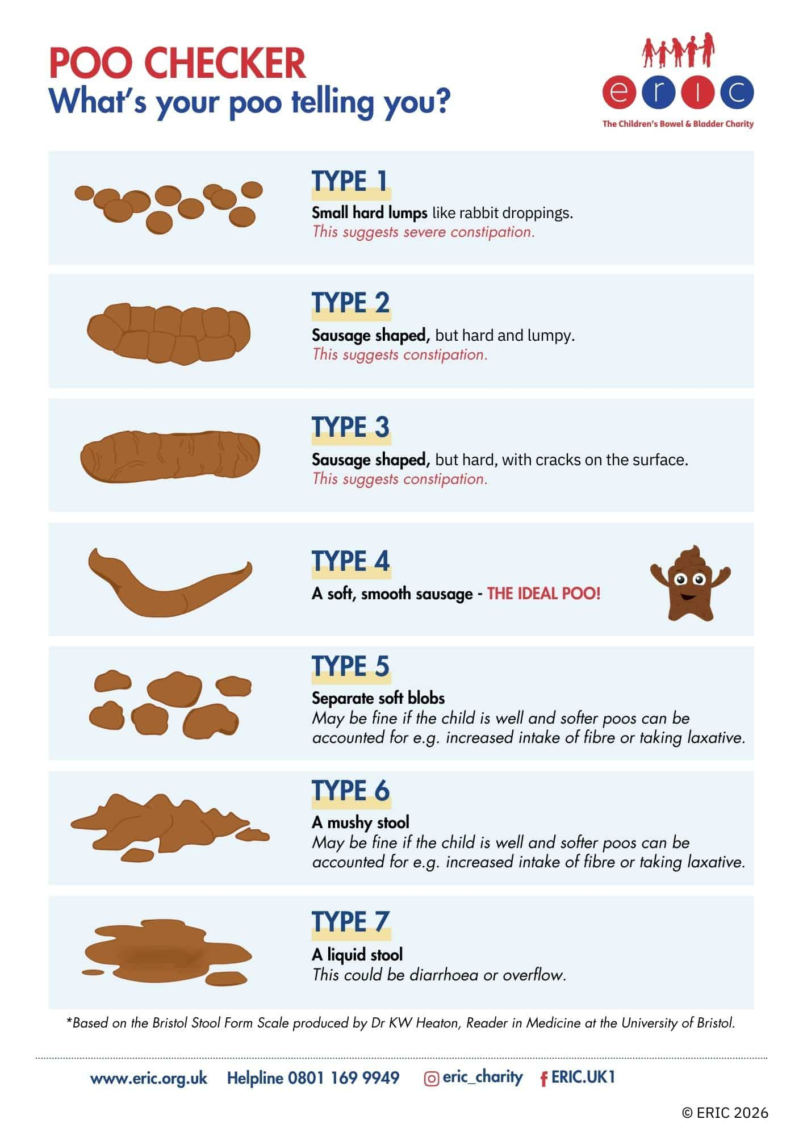
Top tips for identifying a constipated stool:
Stools should be soft, and brown.
Stools should be easy, and pain free to pass.
Loose stools like diarrhoea can indicate overflow soiling.
Dark and sticky stools indicate impaction.
Loose stools will take the path of least resistance, and cause ‘sneaky poos’.

Slide 5
Causes of constipation in CYP with complex needs
Specific conditions mean CYP are more likely to experience constipation, either due to the nature of the condition, or because of the complex needs associated with the condition.
Reduced fluid intake. This might be during a period of being unwell where they have been avoidant of drinking or not tolerated feeds.
A change in diet. Those with blended diets, and milk diets might experience a change in bowel movements if there has been a change to the feed, or ingredients.
Medicines: Some common medicines used to symptom manage in CYP with complex needs can cause constipation as a side effect. For example: clonidine, baclofen, morphine, glycopyronnium bromide. It is important to remember medications are a balance between managing symptoms, and unwanted side effects. You should not discontinue medicines because you feel it causes constipation unless agreed by your healthcare professional.
Reduced mobility: those who are less mobile, or non-mobile are unable to get into the most conducive position to open their bowels. Movement also supports regular bowel movements. Muscle weakness means reduced mobility, and gut motility.
Gut motility: poor motility means the physical act of pushing (peristalsis) a stool out is slow, or difficult, this results in hard, dry stools being in the bowel for longer despite osmotic support.
Challenging behaviour, additional learning needs, or sensory seeking. Non-verbal or limited communication can delay recognition of constipation, and cause impaction.
Negative experience of opening bowels, this is largely linked with toilet training, interoception, additional needs, or just not being ready. Often children will begin to withhold and avoid toileting.
Idiopathic: the cause can be unknown, or unclear, or random.

Slide 6
Organic causes of constipation
The brain & bowels are intimately linked!
Organic causes
  Endocrine and metabolic diseases:
    Diabetes mellitus (with autonomic neuropathy). See the CKS topics on Diabetes - type 1 and Diabetes - type 2 for more information.
    Hypercalcaemia and hyperparathyroidism. See the CKS topic on Hypercalcaemia for more information.
    Hypermagnesaemia.
    Hypokalaemia.
    Hypothyroidism. See the CKS topic on Hypothyroidism for more information.
    Uraemia.
    Myopathic conditions:
    Amyloidosis.
    Myotonic dystrophy.
    Scleroderma.
  Neurological conditions:
    Autonomic neuropathy.
    Cerebrovascular disease. See the CKS topic on Stroke and TIA for more information.
    Hirschsprung's disease. See the CKS topic on Constipation in children for more information.
    Multiple sclerosis. See the CKS topic on Multiple sclerosis for more information.
    Parkinson's disease. See the CKS topic on Parkinson's disease for more information.
    Spinal cord injury, tumours.
  Structural abnormalities:
    Anal fissures, strictures, haemorrhoids. See the CKS topics on Anal fissure and Haemorrhoids for more information.
    Colonic strictures (for example following diverticulitis, ischaemia, or surgery). See the CKS topic on Diverticular disease for more information.
    Inflammatory bowel disease. See the CKS topics on Crohn's disease and Ulcerative colitis for more information.
    Obstructive colonic mass lesions (for example due to colorectal cancer). See the CKS topic on Gastrointestinal tract (lower) cancers - recognition and referral for more information.
    Rectal prolapse or rectocele.

Slide 7
Complicating, or contributing factors to consider for CYP with complex needs
It can be frustrating, and there is no size fits all, each regime will be specific to your child/young person and can be trial and error!
Specific conditions like GM3 Synthase Deficiency. In 70% of cases, CYP were found to experience GORD, vomiting, and constipation. This is evidenced in the case study I will share later on.
Enteral feeding – This can be both good and challenging for constipation. The ingredients need to be just right, and this can be hard when using both formula and blended diets. It can take years to find the right nutrients for your child, and their bowels.
Communication – For those with an LD, or who are non-verbal, they may find it difficult to express what they are feeling or avoiding. This links in with interoception.
Mobility – unable to get into the best position and move around to support motility.
Managing expectations – not all CYP open their bowels everyday. This depends on their own norm.

Slide 8
Constipation management
Lifestyle changes – diet, fluid intake, movement, massage, natural remedies.
Medicines management, and optimisation.
Bowel washouts.
Feeding method changes.
Surgical intervention.
Gut rest.

Slide 9
Managing expectations
In terms of medications, there are generally two types of ‘laxatives’.
Softeners (or osmotic): These medications make the stools soft, and easy to pass, but do not support peristalsis (pushing them out). Types of osmotic softeners are macrogols like Movicol, and syrups like lactulose. There are also softeners like docusate.
Stimulants: These medications support motility, and peristalsis which is the act of pushing stool through the bowels and out. These can be oral, or rectal, and might include senna, bisacodyl, sodium picosulfate,or glycerine.
Once you know the triggers, or causes, you can choose the best medication.
In many cases, it is a case of balancing managing the unwanted symptoms. Which symptoms are more troublesome for example? Which challenge causes your CYP more stress? For example, does the analgesia keep them comfortable, but mean they need constipation medication? Or are they still in pain despite the analgesia, and still constipated?

Slide 10
Managing constipation in CYP with complex needs
Lifestyle/Natural remedies: for those willing to accept oral tasters, fresh orange, or prune juice can support regular, soft bowel movements. For stomach cramps, and bloating, peppermint oil, or tea can help. However, you know what your CYP can tolerate or what is advised by their specific dietician. A healthy balanced diet and include fruits that contain sorbitol such as apples, apricots, grapes (and raisins), raspberries and strawberries. Movement helps to support the stool moving through the bowel. For those who are non-mobile, a bath, and a massage can support pain, discomfort and bowel movements.

Slide 11
Managing constipation in CYP with complex needs
Medications management: there are two elements to medicines management; managing current medications to reduce the risk of constipation as a side effect and introducing medications that work to resolve constipation.
Medicines optimisation: some medications cause constipation:
  Aluminium-containing antacids; iron or calcium supplements.
  Analgesics, such as opiates (up to 80% of patients, even with concomitant use of laxatives) and nonsteroidal anti-inflammatory drugs (NSAIDs).
  Antimuscarinics, such as procyclidine and oxybutynin.
  Antidepressants, such as tricyclic antidepressants.
  Antipsychotics, such as amisulpride, clozapine, or quetiapine.
  Antiepileptic drugs, such as carbamazepine, gabapentin, oxcarbazepine, pregabalin, or phenytoin.
  Antihistamines, such as hydroxyzine.
  Antispasmodics, such as dicycloverine or hyoscine.
  Calcium-channel blockers, such as verapamil.
  Diuretics, such as furosemide.
  Starting medications:
  Macrogols (like Movicol) are always initiated in the first instance. This is osmotic and draws water into the stool.
  If this does not work alone, then a stimulant is added. This is something like senna, but there are various brands, and doses to trial. This may work up to sodium picosulfate.
  If Movicol is not tolerated, or too large a volume, this can be replaced for something like lactulose, or docusate.

Slide 12
Managing constipation in CYP with complex needs
Next steps:
Once you have trialled natural (gentle) remedies, increased fluid intake, movement (where possible), and lifestyle changes, your consultant, may explore the following:
Different methods of feeding, and fluid intake.
Gut rest.
Medicines optimisation – which medication exacerbates constipation? Which symptoms are worse? Which must we manage, and which can we compromise on?
Surgical intervention – this could include a stoma.

Slide 13
Case Study
Young person (J): A 15-year-old boy with ST3GAL5 mutation, resulting in GM3 synthase deficiency syndrome presenting with gastrointestinal dysmotility, feeding difficulties and limited calorie intake and malnutrition. When J is constipated, he wretches, vomits and does not tolerate feeds. He has intermittent gut rest, which means he loses weight, and then feeds are increased again when he has opened his bowels and is more comfortable. Sodium picosulfate also makes him gag, and produce increased secretions increasing the risk of aspiration, particularly overnight. J’s norm is that he needs to open his bowels at least every other day, or he becomes very unsettled, has poor feed tolerance. Then, he needs analgesia which makes the constipation worse.

Slide 14
Case Study
Trialled:
Lifestyle changes
Increase fluid intake
Formula feeds via a gastrostomy
Blended diet via a gastrostomy
Macrogols
Lactulose
Senna
Bisacodyl
Sodium Picosulfate
Peristeen bowel washouts with and without bisacodyl
He has been on Peristeen (for about 1 year now), with bowel washouts every other day (300 ml with added 5-6 mg of bisacodyl). This regime is somewhat effective for 1 week, stools are soft, mucusy, no blood. Then seizures get worse, secretions increase, and there is no bowel output. It is difficult to ascertain, what comes first - neuro deterioration or the dysmotility problem.

Slide 15
Case Study
Current picture:
During these episodes, J is not distended, he does not vomit, but the feeds are stopped and changed to dioralyte each time. This is happening every 1-2 weeks, lasting for 7-10 days. J is in one of his episodes - no bowel output, not tolerating feeds, no abdominal distension, some discomfort. It usually starts with Jesse being upset, mum than stops the feed, as it can cause more discomfort and can lead to vomiting. He is on 3 movicol a day, bisacodyl 5 mls (2.74 mg/ml), added to 300 ml of Peristeen washout, therefore very diluted.
Investigations:
X-ray to determine impaction, or not.
Colonic manometry to review the pressure waves produced when large intestines contract
Digital rectal exam to check for abnormalities in rectum, anus and prostate gland.
A perianal exam to check for any structural abnormalities.
Things to consider next:
1. Separate bisacodyl from bowel washout to ensure the entire dose is received.
2. Jejunal feeding
3. Nutritional rehabilitation
4. Total parental nutrition (TPN)
5. Surgical intervention for colonic dysmotility
6. Ileostomy

Slide 16
Toilet training for CYP with additional, or complex needs
It can be done, but it takes intensive, consistent hard work and can be frustrating, and exhausting.
Are they ready? For those with additional needs, we would not expect them to achieve toileting until around the age of 7,but this can take far longer too. Each CYP is different.
Start as gradual as possible and be consistent both at home and school. Ask your continence advisor, or nurse to facilitate a chat between you and school to ensure everyone is doing the same thing.
Nappies > stand in the bathroom > un-do one side > un-do both sides > sit on the toilet with a nappy > let the nappy sit in the toilet bowel so there is no ‘plop’ > fill the toilet with tissue in a similar way > eventually remove. This is all done gradually and can take months. Each stage may last weeks and may be a challenge. It takes the same behaviour over repeated time to get comfortable.
Rewards for good drinking, eating, being calm in the bathroom, and being calm on the toilet (even if nothing comes out!). Reward the good behaviours associated with good toilet hygiene as opposed to rewarding not being wet, or soiled.
There are some great ERIC courses on interoception, and toilet training for those with additional needs.
Children with additional needs – ERIC
Treating constipation in children with additional needs – ERIC
Toilet anxiety and toilet phobia in children – ERIC
Interoception and toileting – ERIC
7. You may also have support from a local continence service.

Slide 17
Q&A

Slide 18
Webinars
https://vimeo.com/showcase/oxleas-waiting-well

Slide 19
References
Home – ERIC
BNFC (British National Formulary for Children) | NICE
Overview | Constipation in children and young people: diagnosis and management | Guidance | NICE
NHS England » National clinical constipation pathway for primary care for children

